Slide 1

EASWARI ENGINEERING COLLEGE [Autonomous]
INTERNSHIP REPORT
BACHELOR OF ENGINEERING in COMPUTER SCIENCE AND ENGINEERING
TOPIC : NETWORK FILE SHARING
Internship Co-Ordinator : Ms. Shyamala Gowri B
Examiner : Mr. Justin Dhas Y
Technical HR : Mr. Sriram
Manager : Ms. Babu M N
Duration : 3 Months
Name : Gokulakrishnan K J
Reg no : 310620104045
Class : III CSE A
Date : 17-05-2023

Slide 2

Table of Contents
OBJECTIVES
TOOLS AND TECHNOLOGY USED
IMPLEMENTATION
SCREENSHOTS
INTERNSHIP COMPLETION CERTIFICATE

Slide 3

Network File Sharing
Network file sharing in Red Hat Linux refers to the ability to share files and directories across a network of computers running the Linux operating system.
It allows users to access and manipulate files stored on a remote server or other Linux machines, making it easier to collaborate and share resources within a networked environment.
TOOLS AND TECHNOLOGY USED : RedHat Linux

Slide 4
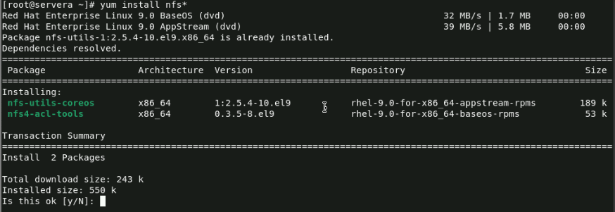
Implementation Of NFS
Open a terminal on your Red Hat Linux system.
Ensure that you have administrative privileges by logging in as the root user or using the nfs command.
Once the package repository information is updated, run the following command to install all packages that begin with the string "nfs":

Slide 5
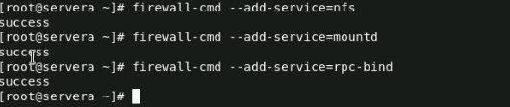
The command "systemctl enable nfs-server.service" is to enable the NFS server service to start automatically at boot time on a Red Hat Linux system.
The command "firewall-cmd --add-service={nfs,mountd,rpc-bind}" is to add the NFS, mountd, and rpc-bind services to the system firewall

Slide 6


The command "firewall-cmd --list-all" is to display a comprehensive list of all firewall settings, including the currently enabled services and zones
The command "mkdir /tom" is to create a new directory called "tom" in the root directory of the file system.”chmod 777 /tom “is to give the read,write and execute access to the /tom file and
The command “Touch /file{1..15}” is to create 15 files in the /tom directory.
The command "ls /tom" is to display a list of all files and directories located in the "/tom" directory.

Slide 7



The command "vim /etc/exports" is to open the "/etc/exports" file for editing using the Vim text editor.
The command "exportfs -r" is to refresh the NFS exports to apply any changes made to the "/etc/exports" file and the command "exportfs -a" is to export all directories listed in the "/etc/exports" file to all clients with the appropriate permissions.
The command "showmount -e" is to display a list of all directories currently exported by the NFS server.

Slide 8
the command "ssh root@serverb" is to establish a secure shell (SSH) connection to the remote server "serverb" as the root user, allowing for remote access and management of the server from a Red Hat Linux system.
The command “mkdir /jerry” is to create a directory in a server
The command "mount 172.25.250.255:/tom/jerry" is to mount the "/tom/jerry" directory from the NFS server with IP address "172.25.250.255" onto the current system's file system on a Red Hat Linux system. This will allow access to the files and directories within the "/tom/jerry" directory on the remote NFS server from the local system. Once the directory is mounted, it can be accessed like any other directory on the local file system.

Slide 9
The command "ls -l /jerry" is to list all files and directories in the "/jerry" directory in a long format, including detailed information such as file permissions, ownership, size, and modification date. This command can be used to examine the contents of the "/jerry" directory
That's it! You have successfully transfered the files from the server A to serverB

Slide 10
Conclusion
Network file transfer in RedHat Linux can pose several risks such as unauthorized access, malware infections, data loss, data theft, and network vulnerabilities. To mitigate these risks, it is important to use secure network protocols, implement access controls, regularly update software and security patches, and perform regular backups of critical data. By taking these precautions, organizations can ensure that their network file transfers are secure and reliable.

Slide 11
